Slide 1
DSC3108: Big Data Mining and Analytics
Lecture 05 (BSCS_3:1)
Topic: Descriptive analytics
Dr. Daphne Nyachaki Bitalo
Department of Computing & Technology
Faculty of Engineering, Design & Technology
Thur 26th Sept 2024

Slide 2

COURSE OVERVIEW
Big Data
Fundamentals and Mining
Data Analytics
Architectures, storage of data
Data Mining Techniques
Descriptive analytics
Predictive analytics
Notes:
Limited empirical investigation into the challenges encountered by Master's degree students
during the dissertation writing process contributes to difficulties in completing dissertations, resulting in elevated dropout rates and delayed program completion. This study seeks to fill this research gap by examining the specific challenges and solutions.

Slide 3
Lecture Objectives and Learning outcomes
The Objectives of this lecture are :
Understand the principles of exploratory data analysis.
Explore relationships between variables
By the end of this lecture, students should be able to:
Practically explore relationships between variables
Use visuals to exhibit relationships
Use statistical tests

Slide 4
Lecture Overview
Concepts in the EDA cycle
Data visualisation
Relationships btn variables
Hands-on practical

Slide 5


DSC1101-Introduction to Data Science
Lecture 7
RECAP

Slide 6
Lesson Recap:
Handled the following under the data flow pipeline
Handling Outliers
Handling Missing data
Handling Duplicates

Slide 7
Lesson recap: EDA
An interactive cycle;
1. Generates questions about your data.
2. Searches for answers by visualizing, transforming, and modeling your data.
3. Uses what you learn to refine your questions and/or generate new questions.
There is no rule about which questions you should ask to guide your research.
However, two types of questions will always be useful for making discoveries within your data. You can loosely word these questions as:
1. What type of variation occurs within my variables? (i.e. variability)
2. What type of covariation occurs between my variables? (i.e. central tendency)
All of the above questions generate DESCRIPTIVE and NOT predictive analyses

Slide 8
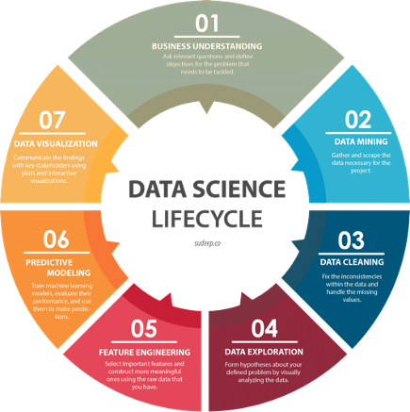
Exploratory Data Analysis (EDA)

Slide 9
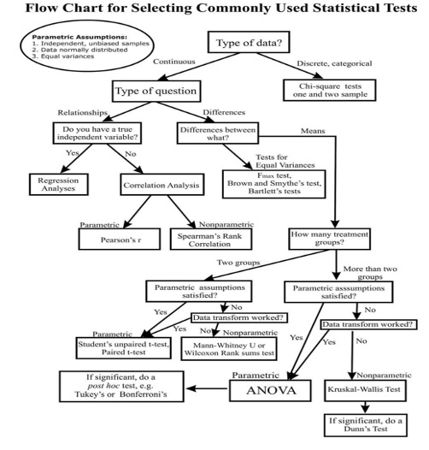
Key statistical tests under EDA

Slide 10
Process of EDA
Data types determine how relationships are explored
We can use visuals (graphs)
E.g. Continuous variables relationship-scatterplot
Explore relationships using statistics

Slide 11
Statistical significance
p-value adds statistical credence to the tests for null/alternative hypotheses stated
Works for normally distributed data (parametric testing)
t-test for continuous variables/data
chi-squared test for categorical/qualitative data
ANOVA for more in-depth analyses

Slide 12
Statistical significance
6. Stats range from 0-1
7. Thresholds for error usually at 0.05
8. p =<0.05 reject null hypothesis
9. p>= 0.05 fail to reject the null hypothesis

Slide 13
Process of EDA: Statistical investigation
Two continuous variables: correlation test (r= -1 to +1)
Strong relationship (either >=+0.7, -0.7)
Negative correlations exhibit an inverse relationship (i.e. one increases, other decreases)
Medium relationship (ranges from 0.3 to 0.69)
Less than 0.3 or -0.3 is a weak relationship

Slide 14
Statistical investigation: T test
Works for normally distributed data (parametric testing)
t-test is suited for continuous variables/data

Slide 15
Statistical investigation: ANOVA
Tests relationship between categorical and continuous variables
Hypotheses: Assumption/presumptive statement
Null hypothesis: Negative manner (e.g. There’s NO relationship between state and revenue)
Can be true if; p-value is > 0.05 (No relationship between state and revenue)

Slide 16
Statistical investigation: ANOVA
However;
If p< 0.05, then we reject the null hypothesis (Relationship between the variables)
Therefore accept alternative hypothesis

Slide 17
Statistical investigation: ANOVA
ANOVA test also;
Tests the difference in mean values of continuous variable across each categorical variable
Null hypothesis: No difference in means across categories

Slide 18
Statistical investigation: Chisquare test
Chisquare test (X2)
Generates contingency table of the categorical variables
Generates a p-value
Null Hypothesis: No relationship/no correlation between the variables

Slide 19
In-class assignment
Using the Cassava dataset on Moodle:
What is the relationship between two continuous variables?
What is the relationship between two categorical variables?
Relationship between one categorical and one continuous variable?
Submit your assignment as a jupyter notebook by 27th Sept 2024.

Slide 20
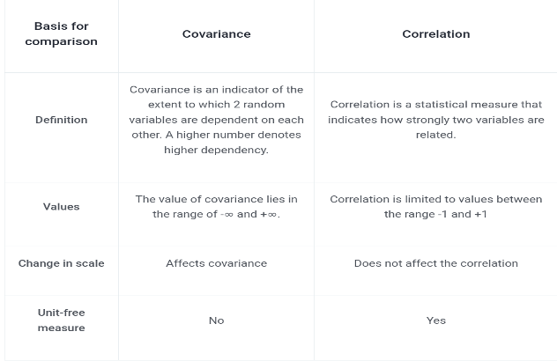
Correlation is NOT covariation

